Slide 1




(An Autonomous Institute, Affiliated to Savitribai Phule Pune
University, Pune) 2023-2024
Sanjivani College of Engineering, Kopargaon
Heart Disease Prediction System
Presented By-
57 – Krushna Dilip Gund
61- Adesh Arun Jadhav
65 – Shravani Anil Jadhav
66 – Swapnil Jalindar Jadhav
Guided By : Dr.T.Bha1skar

Slide 2
Contents
Introduction
Problem Definition
Literature Review
Dataset
Model/Algorithm
System Design
Implementation
Conclusion
Reference

Slide 3
Introduction
The Heart Disease Prediction System is an innovative tool designed to assess an individual's risk of developing cardiovascular diseases.
Utilizing advanced machine learning algorithms and medical data analysis techniques, the system aims to provide accurate predictions based on various risk factors and patient information.
Data Integration, Machine Learning Algorithms, Feature Selection, Model Training and Validation, Risk Assessment, User Interface and More Technologies are used.
By leveraging cutting-edge technology and data-driven approaches, the system has the potential to revolutionize how heart disease is diagnosed, managed, and prevented, ultimately leading to improved patient outcomes and population health.

Slide 4
Problem Statement
Cardiovascular diseases, including heart disease, are a leading cause of Mobility and mortality Globally. Early detection and intervention play a crucial role in preventing and managing heart related conditions. Machine learning techniques offers a promising avenue for predicting heart disease based on relevant health parameters.

Slide 5
Literature Review
1.Predictive Data Mining for Medical Diagnosis: An Overview of Heart Disease Prediction
Jyoti Soni M.Tech (CSE), Ujma Ansari Professor, Dipesh Sharma, Sunita Soni Sr. Associate Professor
Introduction-
Data mining techniques have shown promise in predicting heart diseases by extracting meaningful patterns from medical datasets. Studies comparing algorithms like Naive Bayes, Decision Trees, and Neural Networks have demonstrated the effectiveness of these methods in accurately predicting the likelihood of patients developing heart disease.
Additionally, approaches such as genetic algorithms for attribute subset optimization, association rule discovery, and rough set theory for managing uncertainties in medical data have further improved prediction accuracy and knowledge extraction.
Methodology-
The authors conduct a comprehensive survey of recent publications across medicine, computer science, and engineering. They focus on evaluating predictive and descriptive data mining techniques, particularly using datasets from the Cleveland Heart Disease database.
Results-
Through experiments, they find that Decision Tree and Naïve Bayes perform best for heart disease prediction, while other methods like K-NN and Neural Networks show less promising results. Additionally, applying genetic algorithms enhances the accuracy of Decision Tree and Bayesian Classification by optimizing feature selection.

Slide 6
2.Decision Support in Heart Disease Prediction System using Naive Bayes
Mrs.G.Subbalakshmi (M.Tech), Mr. K. Ramesh M.Tech, Asst. Professor, Mr. M. Chinna Rao M.Tech,(Ph.D.) Asst. Professor,
Introduction-
Data mining techniques, particularly Naive Bayes, have shown promise in predicting heart disease by extracting meaningful patterns from healthcare datasets.
Studies comparing algorithms like Naive Bayes, K-NN, and Decision Trees found Naive Bayes to be effective, with applications like the Intelligent Heart Disease Prediction System (IHDPS) demonstrating high accuracy.
To address underutilization of healthcare data and biases in decision-making, the proposed Decision Support in Heart Disease Prediction System (DSHDPS) integrates Naive Bayes with patient records, offering efficient and accurate heart disease prediction based on clinical attributes like age, sex, and blood pressure.
Methodology-
The study used Naïve Bayes classification and data from the Cleveland Heart Disease database to develop the DSHDPS, focusing on key patient attributes like age, sex, blood pressure, and blood sugar levels.
Results-
The DSHDPS, primarily driven by Naïve Bayes, effectively predicted heart disease, offering insights for clinical decisions and potentially reducing medical costs.

Slide 7
3.Intelligent Heart Disease Prediction System Using Data Mining Techniques
Sellappan Palaniappan, Rafiah Awang Department of Information Technology
Introduction-
The healthcare industry faces challenges in leveraging vast amounts of data effectively for decision-making. This system aims to extract hidden patterns and relationships from healthcare data to assist in diagnosing heart disease and making intelligent clinical decisions.
Methodology-
The researchers employed the CRISP-DM methodology, comprising six phases: business understanding, data understanding, data preparation, modeling, evaluation, and deployment. Three data mining techniques—Decision Trees, Naïve Bayes, and Neural Network—were used to build predictive models. The models were trained, evaluated, and validated against the test dataset using Lift Chart and Classification Matrix methods.
Results-
The study assessed predictive models for heart disease diagnosis, finding Naïve Bayes most effective, followed by Neural Network and Decision Trees. These models successfully handled complex queries, with Naïve Bayes excelling in predicting heart disease cases and Decision Trees in non-cases

Slide 8
4.Logistic regression technique for prediction of cardiovascular disease
Ambrish G, Bharathi Ganesh, Anitha Ganesh, Chetana Srinivas, Dhanraj, Kiran Mensinkal
(East West Institute of Technology, Anjana Nagar, Bangalore 560091, India)
Introduction-
Cardiovascular disease (CVD) is a leading cause of global mortality. Early prediction is crucial for effective treatment and prevention. This research focuses on LR's application to classify CVD presence using a UCI dataset.
Methodology-
The study preprocesses data, selects features based on correlation, and splits the dataset into training and testing sets. LR is used for binary classification of CVD presence.
Results-
LR achieves 87.10% accuracy with a 90:10 training-testing split, demonstrating improved performance with more training data.

Slide 9
5.Leveraging Regression Analysis to Predict Overlapping Symptoms of Cardiovascular Diseases
Sara Ghorashi , Khunsa Rehman , Hend Khalid Alkahtani 4(Member, IEEE), Ahmed H. Samak , Ivan Cherrez-ojeda , Anam Riaz And Amna Parveen
Introduction-
Cardiovascular diseases (CVDs) are a leading cause of mortality globally, necessitating timely prediction for effective treatment and prevention. This research explores using deep learning-based regression analysis on a dataset from UAE hospitals to predict CVDs early.
Methodology-
The study preprocesses data, selects features through regression analysis, and employs a Long Short-Term Memory (LSTM) neural network for prediction. Regression analysis enhances predictive capabilities using information like age, symptoms, and specific CVD details.
Results-
The LSTM model shows promise in predicting various CVDs, especially in scenarios with overlapping symptoms. it achieves 71.5% accuracy in predicting coronary heart disease, rising to 86.7% accuracy with a combination of symptoms. Specific symptom combinations yield a high accuracy of 90.6%.

Slide 10
Dataset: Heart Disease Dataset
This data set dates from 1988 and consists of four databases: Cleveland, Hungary, Switzerland, and Long Beach V.
It contains 76 attributes, including the predicted attribute, but all published experiments refer to using a subset of 9 of them. The "target" field refers to the presence of heart disease in the patient. It is integer valued 0 = no disease and 1 = disease.
https://www.kaggle.com/datasets/johnsmith88/heart-disease-dataset?resource=download

Slide 11
1.Age | 8. maximum heart rate achieved
2.Sex | 9. exercise induced angina
3. chest pain type (4 values) | 10. oldpeak = ST depression induced by exercise relative to rest
4. resting blood pressure | 11. the slope of the peak exercise ST segment
5. serum cholestoral in mg/dl | 12. number of major vessels (0-3) colored by flourosopy
6. fasting blood sugar > 120 mg/dl | 13. thal: 0 = normal; 1 = fixed defect; 2 = reversable defect
7. resting electrocardiographic results (values 0,1,2)

Slide 12


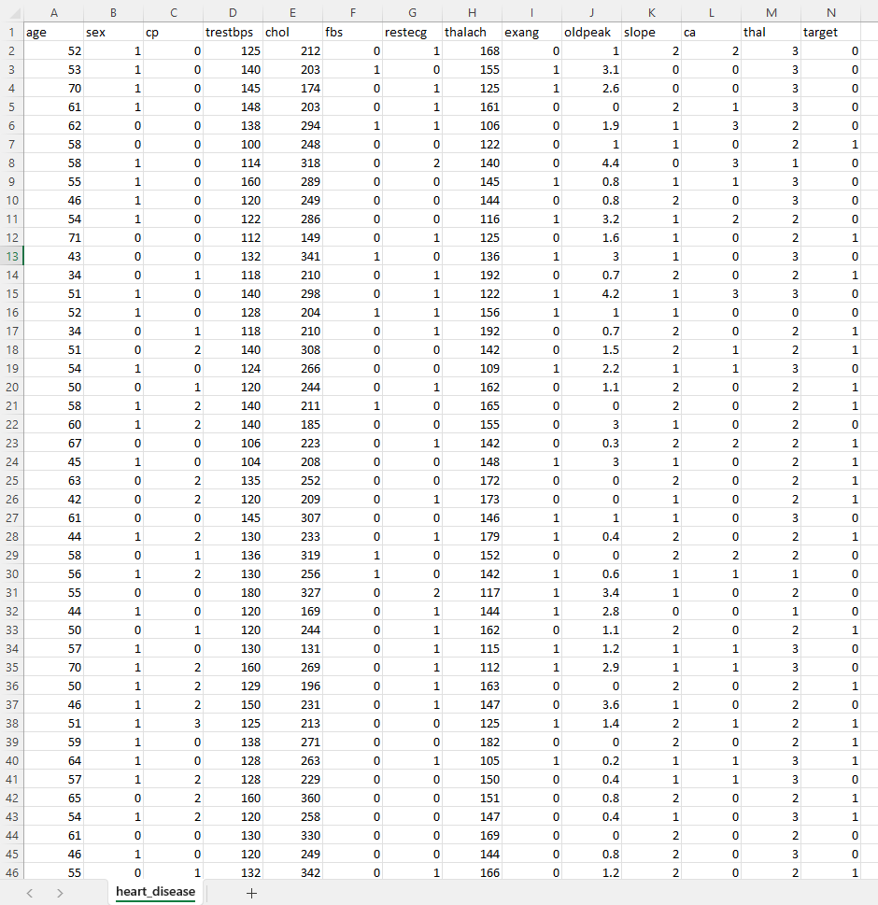
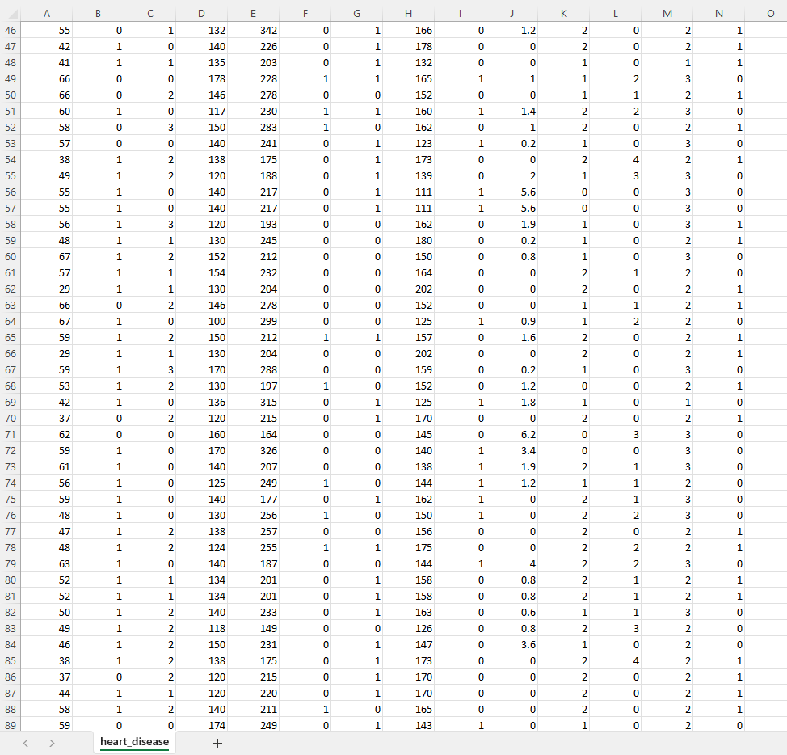

Slide 13


Model/Algorithm
Data Acquisition
Data Pre-
Processing
Logistic Regression is a statistical and machine-learning technique classifying records of a dataset based on the values of the input fields.
It predicts a dependent variable based on one or more sets of independent variables to predict outcomes. It can be used both for binary classification and multi-class classification.
Feature Selection
Training Data
Testing data
Logistic Regression
Prediction Result

Slide 14
System Design
Data Loading and Preprocessing
The data (Hdata.csv) is loaded into the system.
Output: Processed data in a format suitable for model training. Getting some info about the data
Splitting Features and Target
Output: Here the target column is separated from all rest of the features.
Splitting the data into training data and testing data.
The training data is fed into the Logistic regression regression model.
Output: Trained model ready for prediction.
Model Evaluation
The testing data is used to evaluate the model.
Output: Based on the provided input the prediction is displayed.

Slide 15
Web Application Development
Input: User interacts with the web application.
Output: The user interface is displayed in the web browser.
User Input and Prediction
Input: User fills in the form by providing the required 13 fields.
Output: Upon submitting the form, the predicted result is displayed on the web page.
Model Prediction
Input: The user-provided required medical values as input to the trained model.
Output: The model predicts the heart disease based on the provided input, which is then displayed to the user.
Deployment:
The Flask application is deployed on a server.
Output: The deployed application is accessible via a URL, allowing users to interact with it as described above.

Slide 16
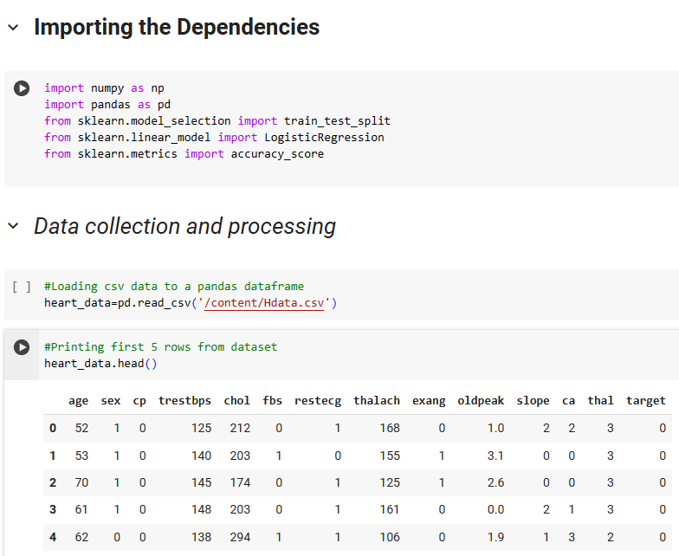
IMPLEMENTATION

Slide 17
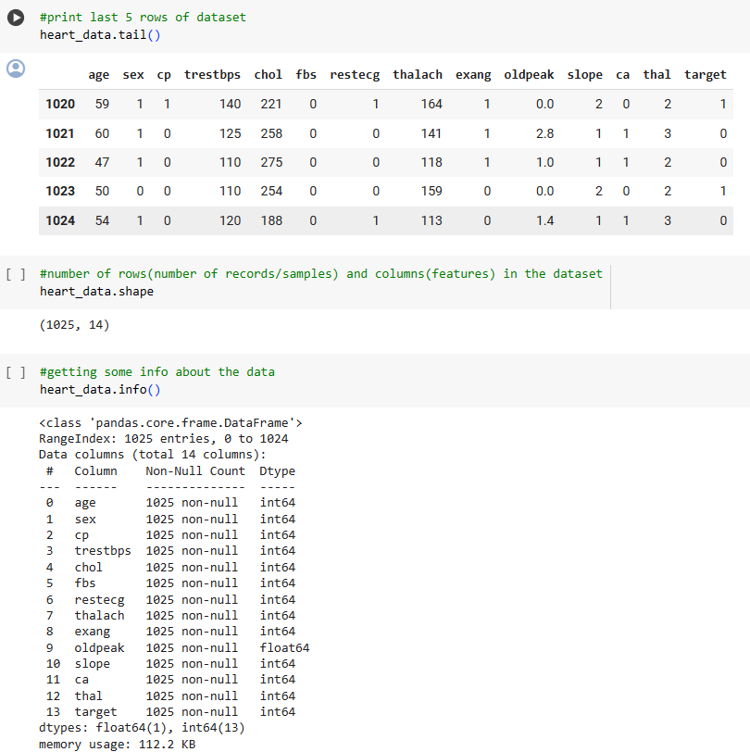

Slide 18
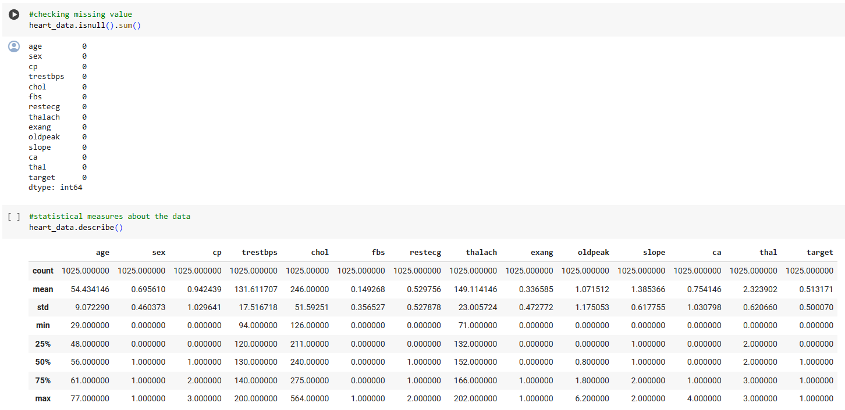

Slide 19
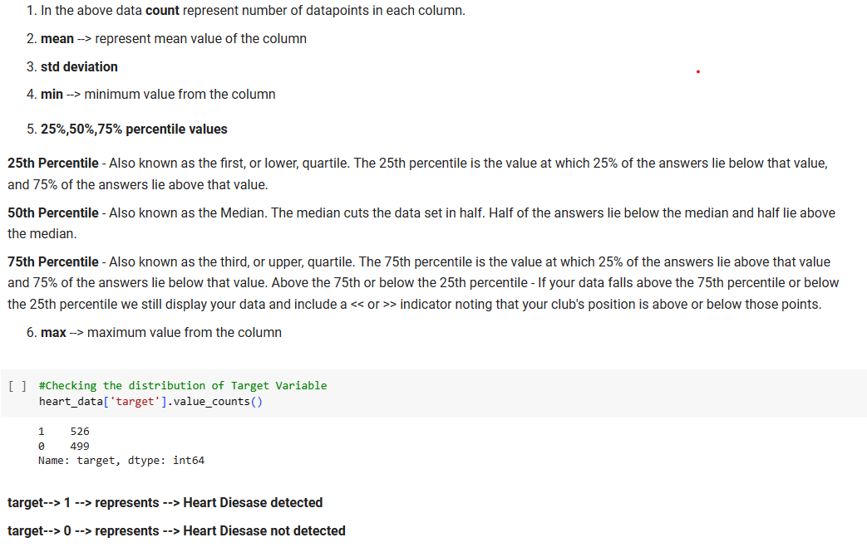

Slide 20
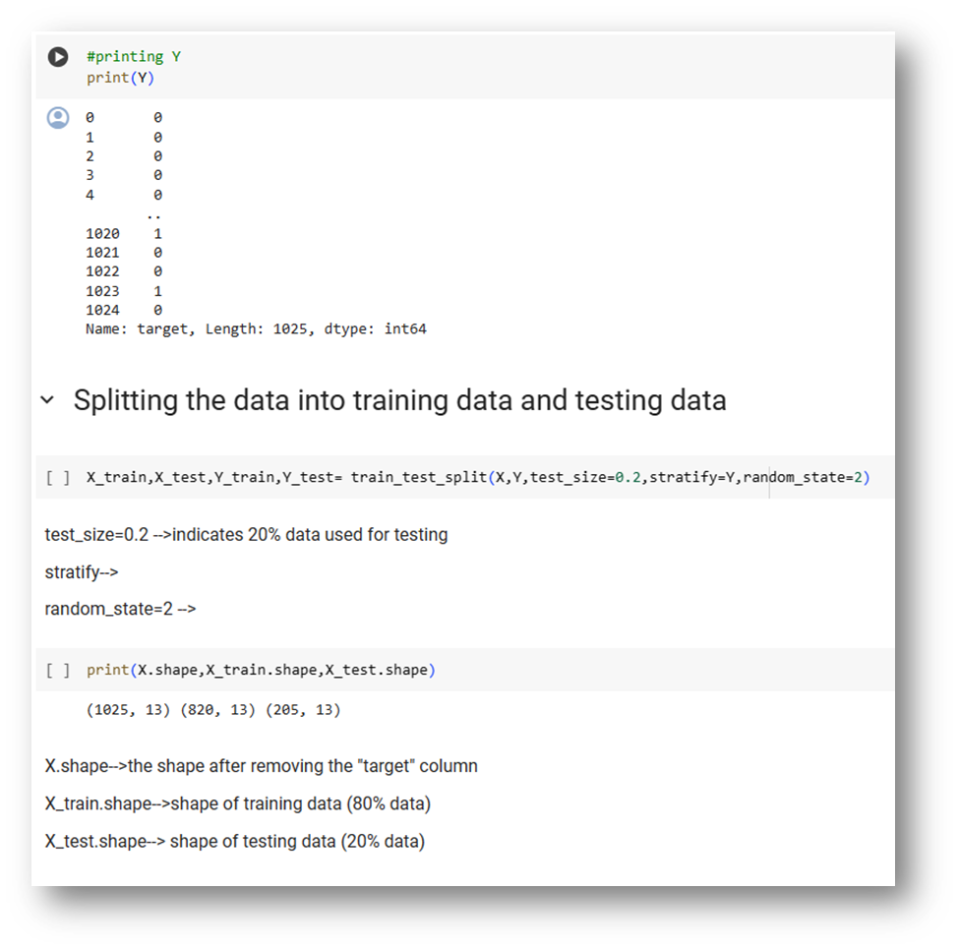
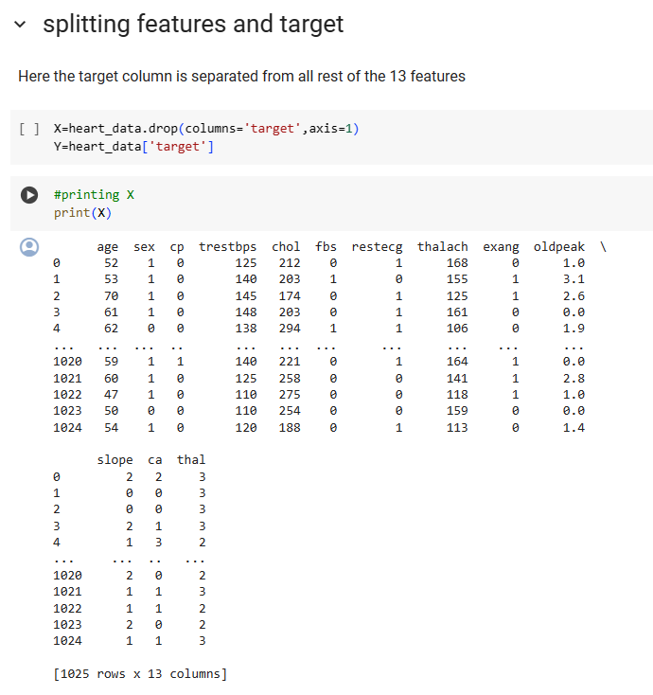

Slide 21
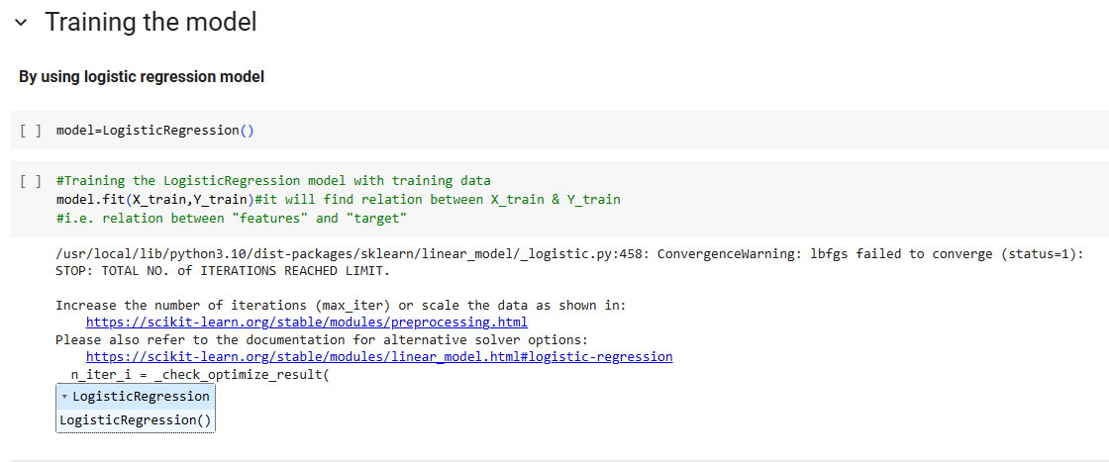

Slide 22
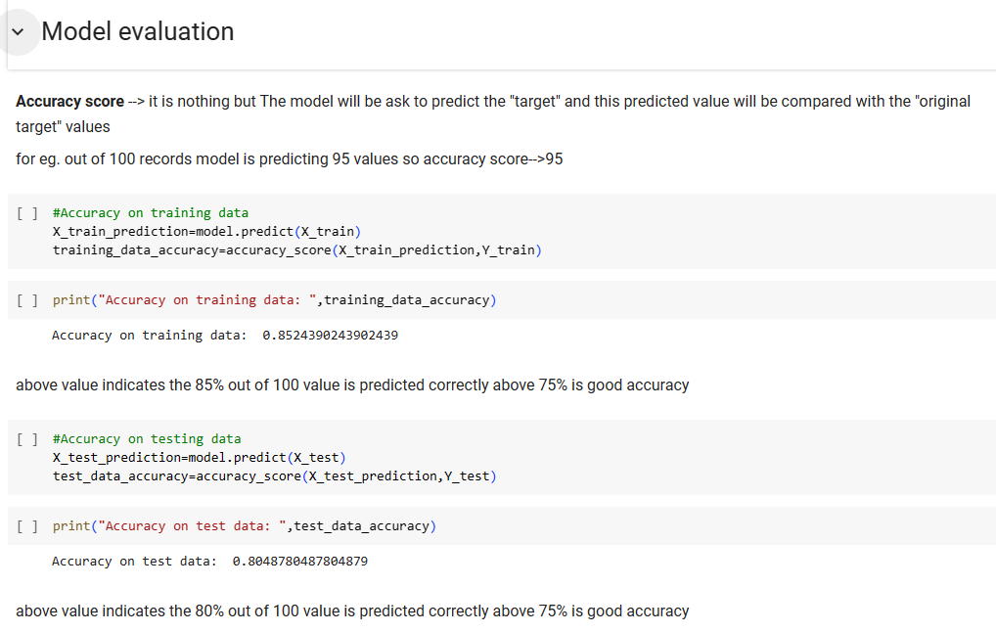

Slide 23
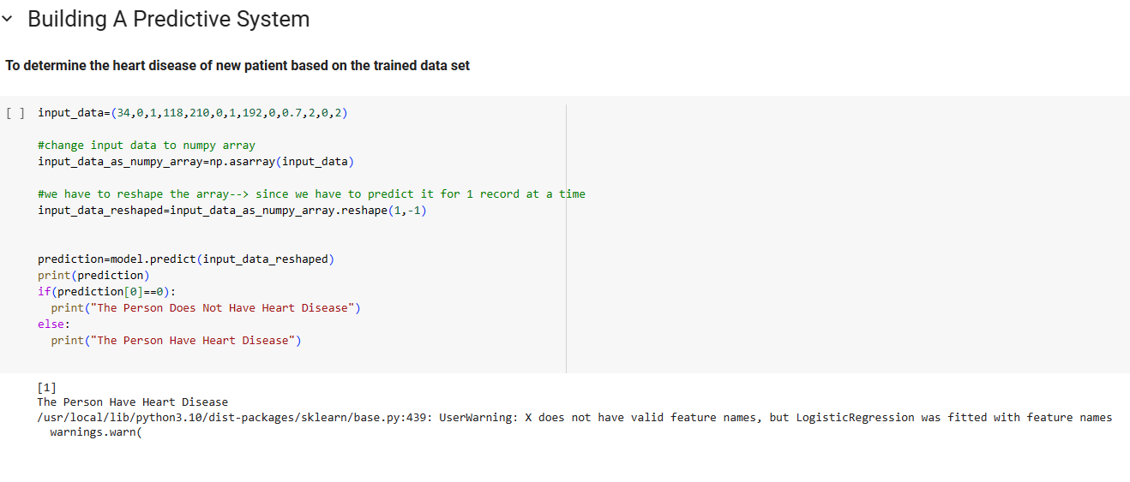

Slide 24
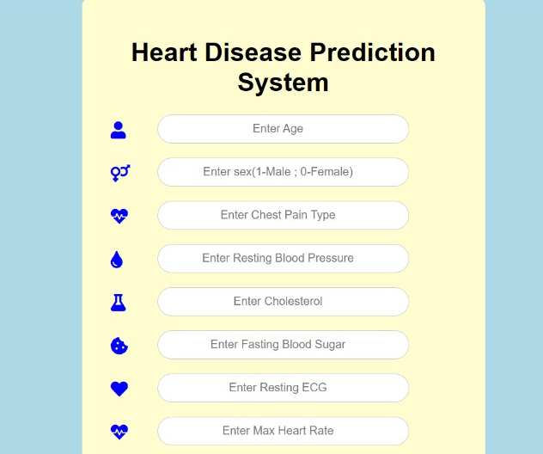
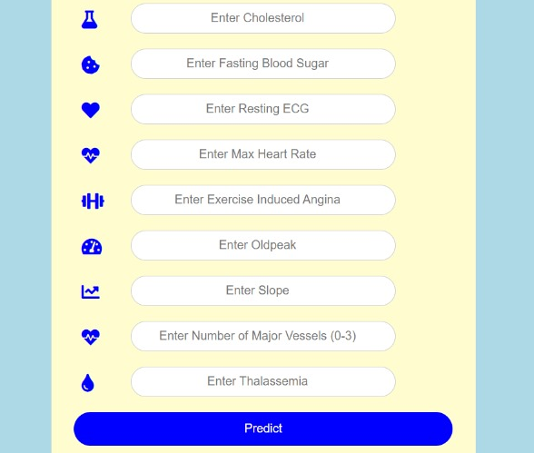
Result

Slide 25
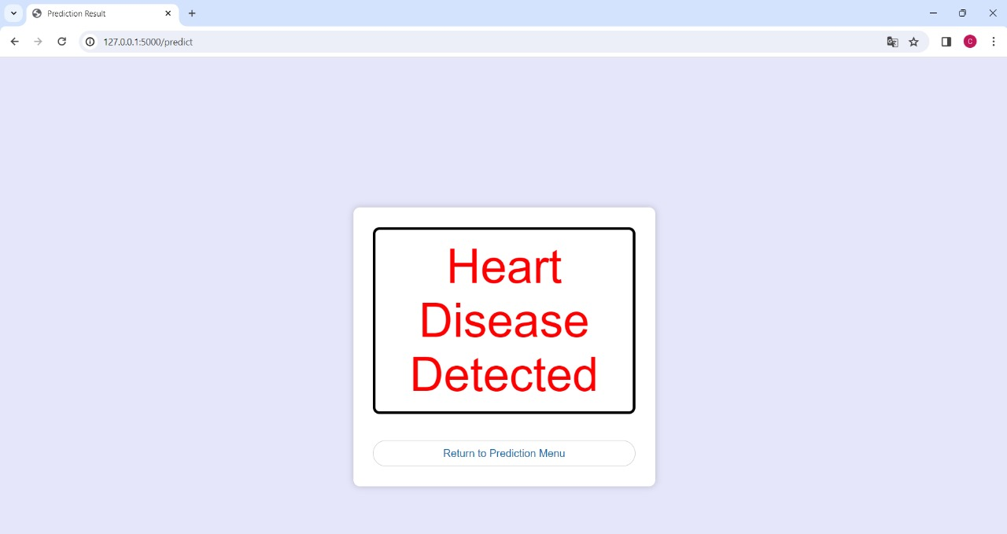

Slide 26
Conclusion
In summary, leveraging the power of the Logistic Regression model, our upcoming system aims to offer a reliable and accurate prediction of heart disease based on the insights gained from the training data. This project marks the initial steps toward creating an impactful tool in the domain of heart disease prediction, with future iterations promising further advancements and practical applications.

Slide 27
References
https://www.kaggle.com/datasets/johnsmith88/heart-disease-dataset?resource=download
https://ieeexplore.ieee.org/abstract/document/4493524
Logistic regression technique for prediction of cardiovascular disease – ScienceDirect
ML | Heart Disease Prediction Using Logistic Regression . - GeeksforGeeks
https://www.researchgate.net/publication/368848738_Heart_Disease_Prediction_Using_ Logistic_Regression
https://www.sciencedirect.com/science/article/pii/S2666285X22000449

Slide 28


